Slide 1
Intern Presentation
Jeremy Meyer

Slide 2
Section I
Introduction

Slide 3
BackgrounD
The Collections Team
Their job is to collect payments
They can be collected that same day or arranged for a later date.
They collect money for 3 different products
RTO, Snap Loan, Credit+
Introduction

Slide 4
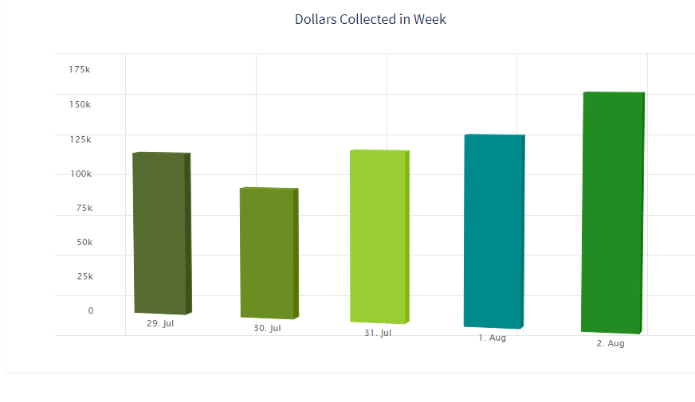
Terms
Origination (Same Day) Dollars
These are dollars collected in the same day
July 2019 – $2.6 Million
About 125K a day
Introduction

Slide 5
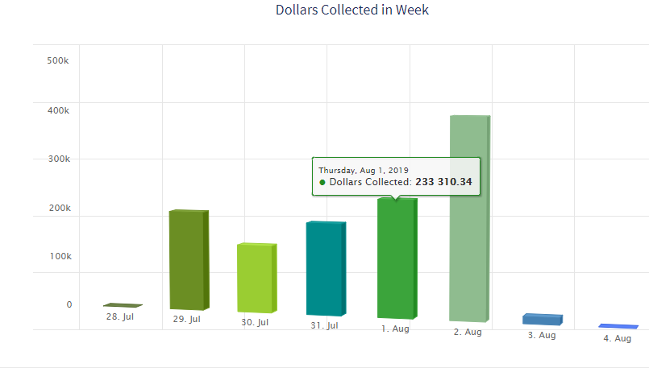
Terms
Arrangement (total) Dollars
Dollars that were arranged to be collected on a particular day
July 2019: $4.7 Million
About $200K per day
Total Dollars Includes both arranged and same Day
Introduction

Slide 6
The Problem
What are “reasonable” target dollars for each day?
The team wants to set goals for each day
Separate goals by:
SameDay / Total
Product type (RTO, SLN)
Solution: Forecasting (prophet) and Shiny Dashboards
Introduction
Notes:
Although an existing timeseries model was up, it needed to be updated

Slide 7
The Plan
Train 4 Models
Predictions
Database
Dashboards
Airflow
2 Product Types
2 Collection types
Model Tuning
Python Script
Write to database
Cache predictions for a month
Show predictions with realtime data
Collections team can see targets
Automatically generate new predictions monthly
Introduction
Notes:
Reasons:
The product and collection types may have different patterns/structure behind them, so we will train 4 models separately
3. We will cache the predictions for the month to 1) save loading time on the dashboards and so 2) collection team can set fixed monthly goals.
4. We will deliver this via shiny dashboards so it updates realtime
5. Airflow will auto run python script at beginning of each month so predictions stay current.

Slide 8
Section II-a
Prophet Package

Slide 9
Prophet Package (Python)
Timeseries Analysis
Bayesian forecasting using a GAM
Model:
Where:
g(t) is the overall “trend” component (with changepoints)
s(t) are the seasonal components
h(t) – holiday components
ε are assumed to be normally distributed (for confidence bands)
Advantages
Models fit quickly (interactively explore modifications → Shiny)
Can interpret user-defined component effects
Prophet

Slide 10
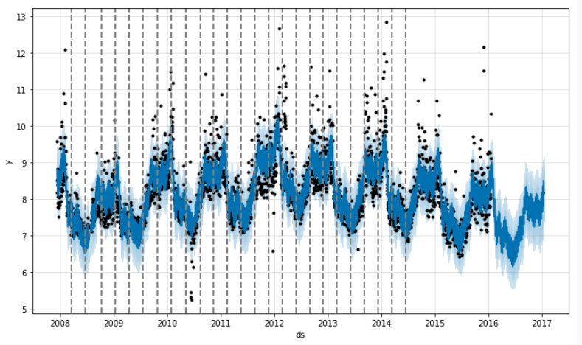
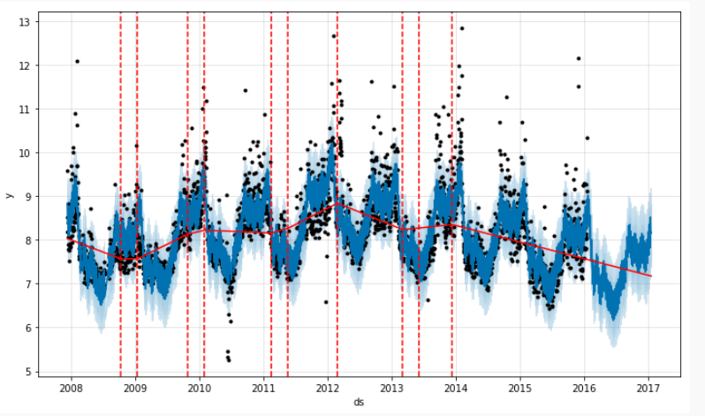
Prophet FOrecasting
Trend Component
Can be linear or logistic
Each potential changepoint has a magnitude → δ_{i}
δ_{i} ~ Laplace(0, τ) prior
Τ = “prior scale” tuning parameter
Trend rate at time t:
Base rate + Σ_{i<t} δ_{i}
Thus, g(t) = (trend rate)*t + intercept
Changepoints are assumed to continue at the same rate for future forecasts
Prophet
Notes:
Explain number of changepoints

Slide 11
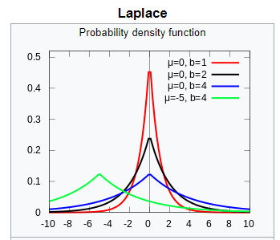
Laplace Distribution
Also Double Exponential
Scale parameter (b) determines model flexibility
Higher scale = More flexibility, prone to overfit
Smaller Scale = More regularization, simpler model
Prophet

Slide 12
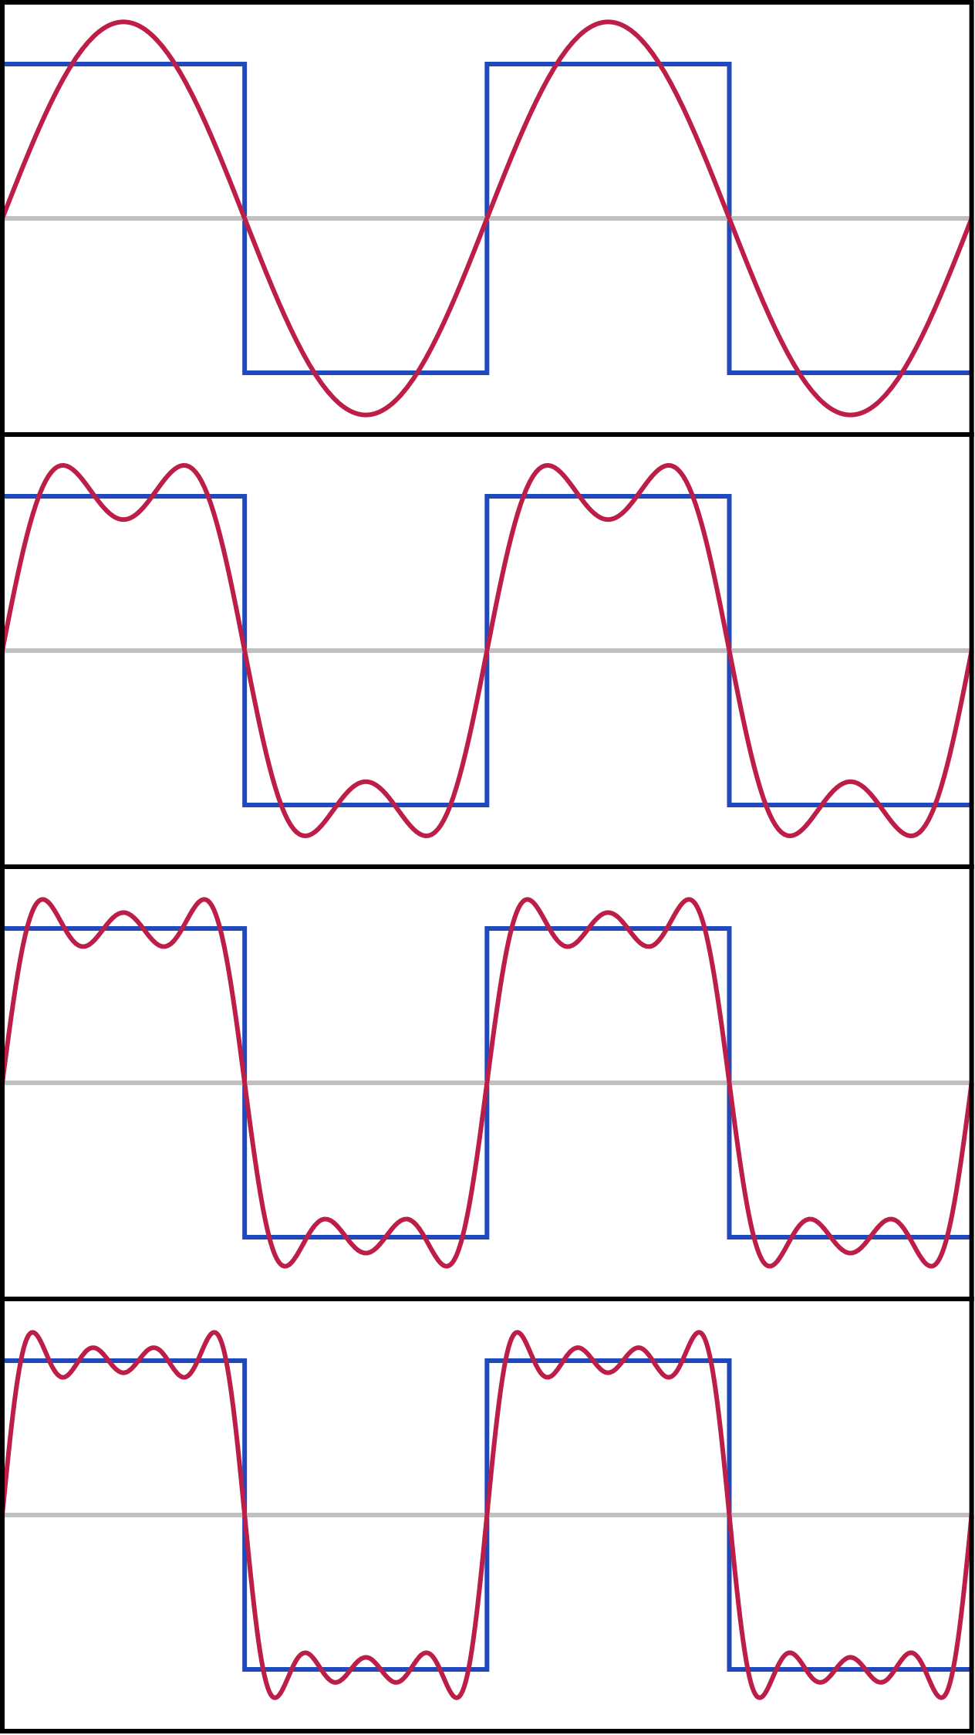
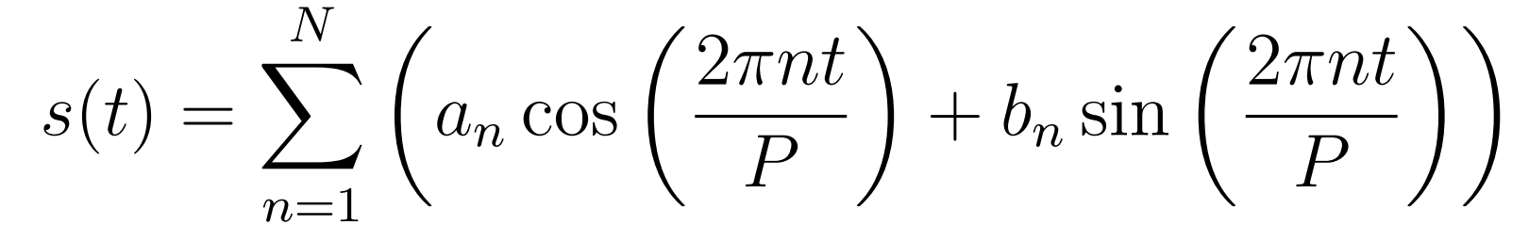
Prophet Forecasting
Seasonal Effects
Calculated from Fourier Series
Where
N = Fourier Order (can tune)
Higher N → More Flexible
a_{n} and b_{n} ~ Normal(0, σ²) prior
2N parameters to estimate
P = period of seasonality (can tune)
Prophet

Slide 13
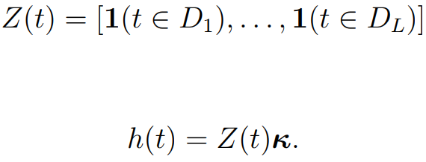
Prophet Forecasting
Holiday Effects
Effects of holidays (D_{i}) are assumed independent
Treated as indicator variables
κ ~ Normal(0, ν²) prior
Can add holiday window periods (treated as separate holidays)
Prophet

Slide 14
Section II-b
The data

Slide 15
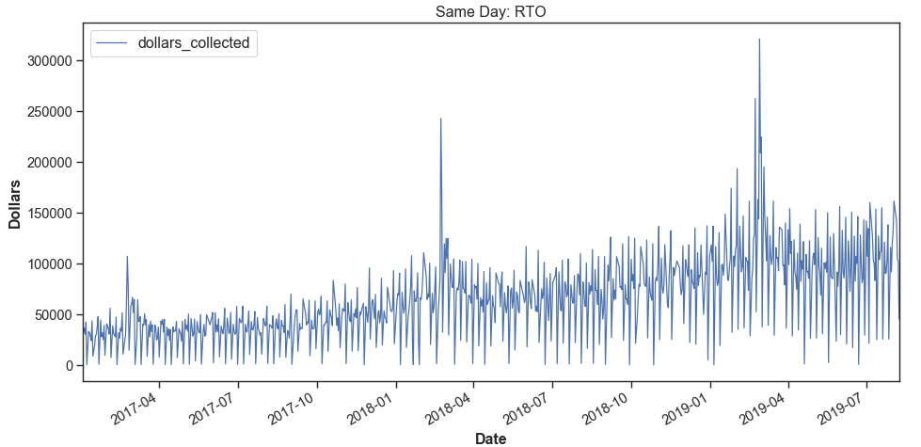
RTO Data
The data
Notes:
Seasonal effects are larger as the trend increases. Spikes in Feb. Definite weekly seasonality

Slide 16
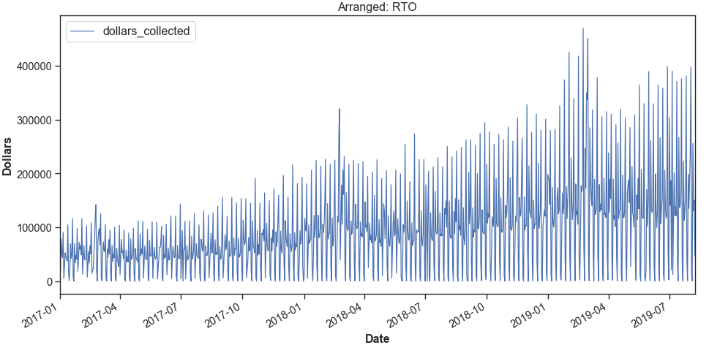
RTO Data
The data

Slide 17
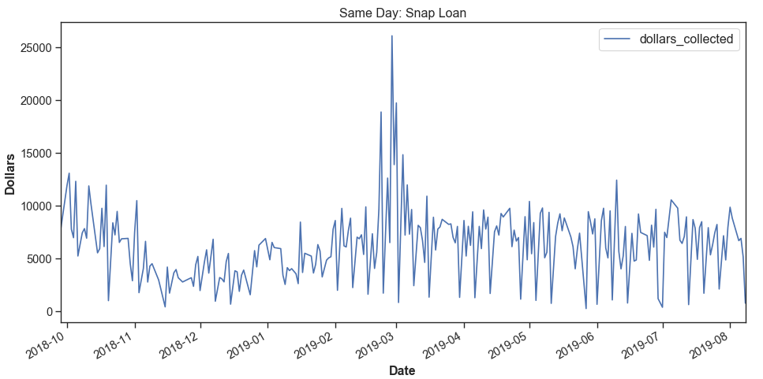
Snap Loan Data
The data
Notes:
These both take a dip around holiday season. Weekly seasonality is present, but hard to distinguish year effects

Slide 18
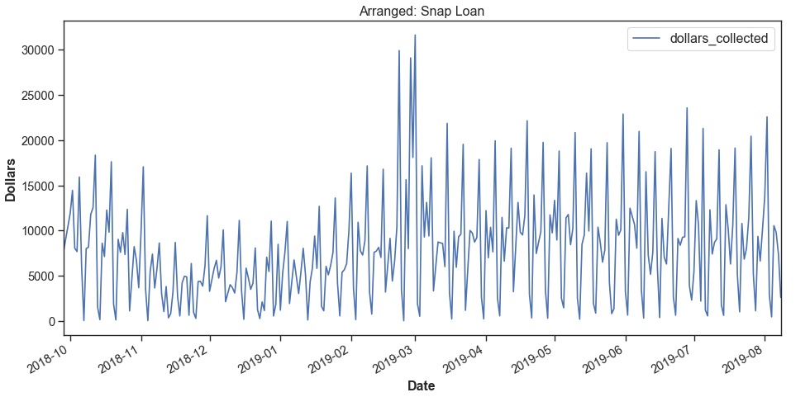
Snap Loan Data
The data

Slide 19
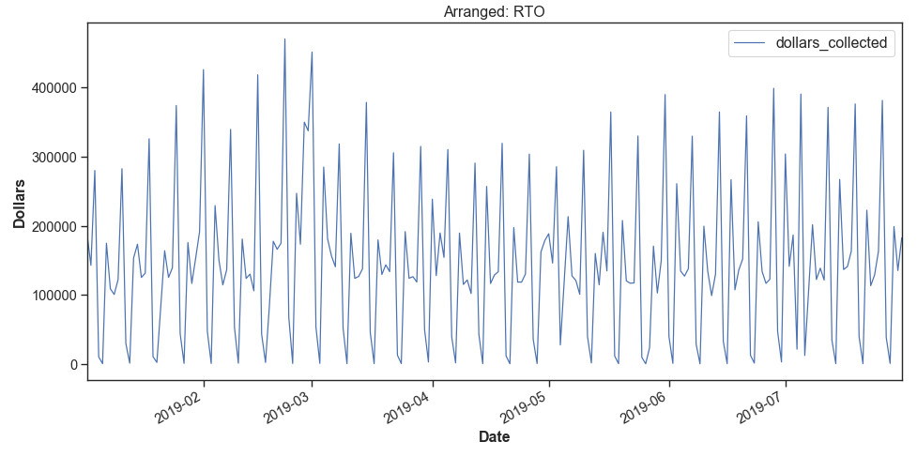
EDA
Most seasonality effects are multiplicative
Weekly seasonality present
Dips on Saturdays, spikes Friday/Monday
Try yearly/monthly/quarterly seasonality
Spikes occur late Feb (Tax season)
RTO (Increasing), Snap Loan (Leveling off)
Data Cleaning: Threw out Sundays
Model: Add Tax season and US holidays
Day | Mean
Mon | $200K
Tue | $136K
Wed | $147K
Thu | $140K
Fri | $354K
Sat | $033K
The data

Slide 20
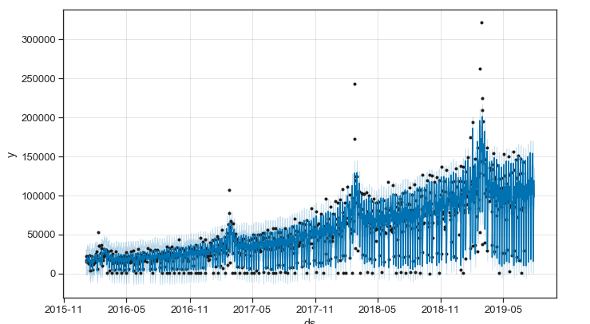
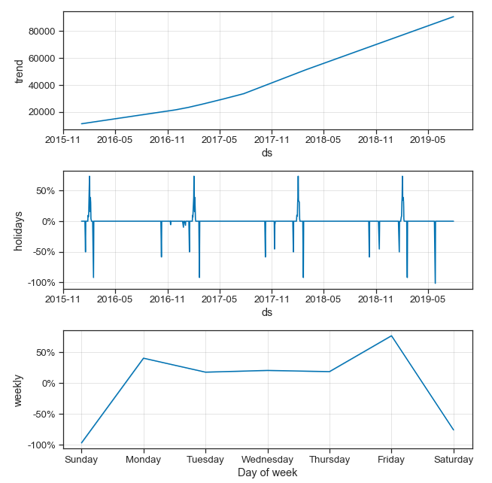
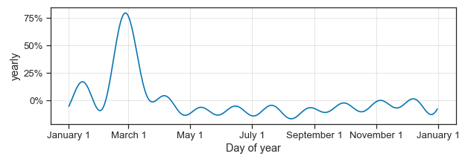
Model Components
Ex. Same Day + RTO
The Model

Slide 21
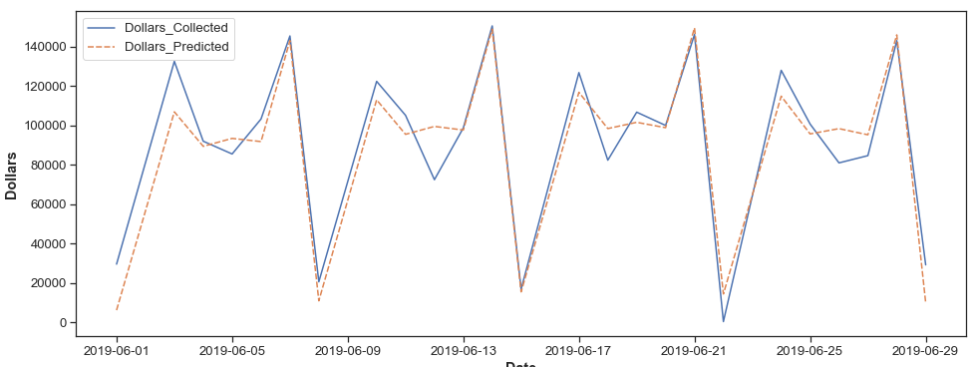
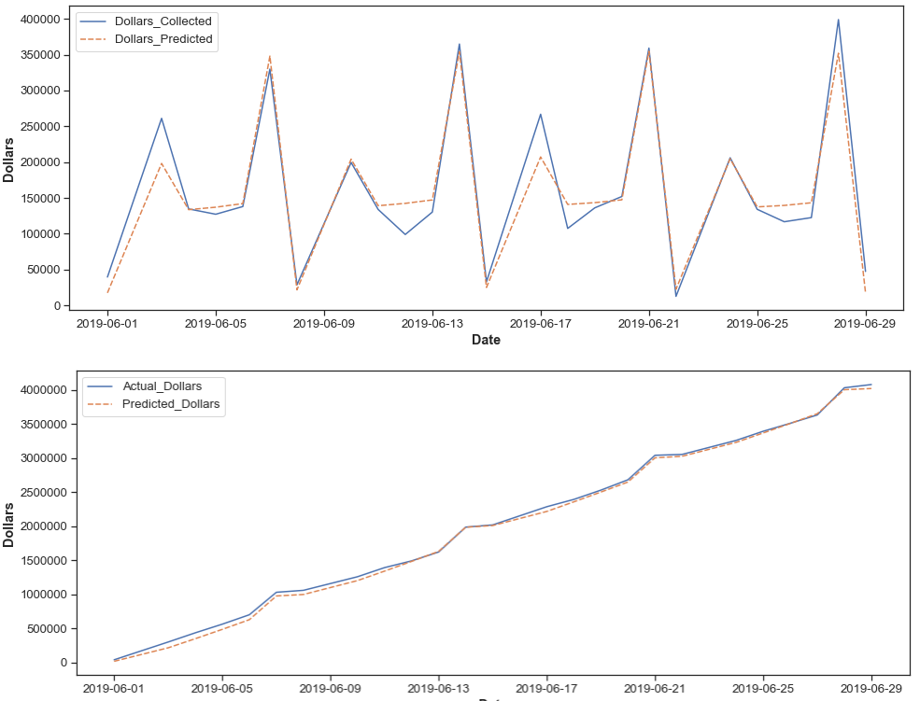
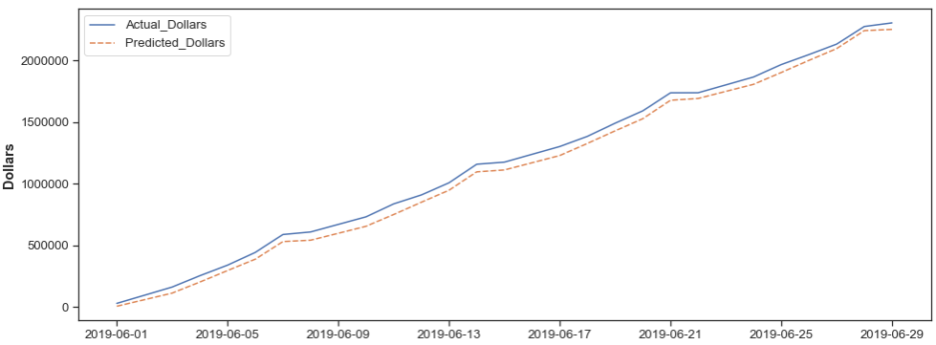
Initial Model Fit
Same Day - RTO
Total - RTO
MAE: $10,045
Cumulative MAE: $56,432
MAE: $18,340
Cumulative MAE: $39,359
The Model
Notes:
Problem: Without tuning, fit appears pretty good. However, some are systematically underestimating the total

Slide 22
Can we do better?
Hyperparameters
Trend Changepoints:
Number (25)
Range (80%)
Prior scale (.05)
Locations
For Each Seasonality:
Which seasons to include?
Period
Fourier Order (3 week, 10 yr)
Prior scale (10)
Type (Additive)
Holidays:
Prior Scale (10)
User Defined
The Model
Notes:
In addition to deciding

Slide 23
Section III
Tuning/
Cross Validation

Slide 24
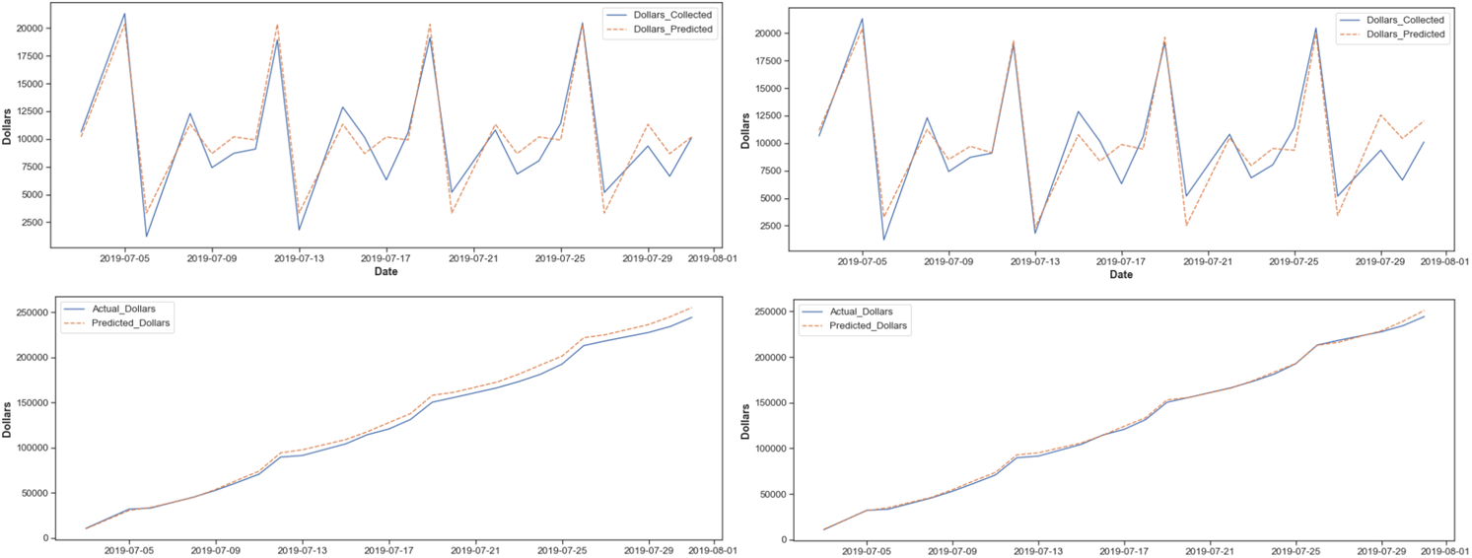
Cumulative MAE
Sometimes models with lower MAE had terrible cumulative graphs… (Snap Loan – Arranged)
Collections team wants to be able to set monthly goals as well.
Technically the left model had a lower MAE (1404 vs 1477)
But Left Cumulative MAE was 5635 (vs 1907)
The Model
Notes:
Fix this one tomorrow

Slide 25
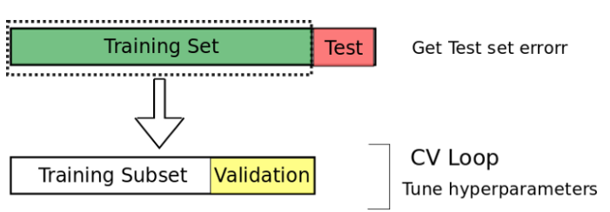
Cross Validation
Training set: Jan 2016 – May 2019
Validation set: June 2019
Test set: July 2019
Due to time constraints and convoluted nature of tuning so many hyperparameters, simple time-dependent CV was used
Future improvements: Nested CV
Cross Validation
Notes:
Time constraints – Collections just wants a number up right now
Typically nested CV is used for timeseries

Slide 26
Model Tuning
Method (Incomplete grid Search)
Tune Fourier Orders for each seasonality effect
Tune Fourier Prior Scales all at once
Tune Holiday Prior Scale
Tune Changepoint prior scale, proportion, and number
Compare test set error (MAE and CUM_MAE) with untuned model
Cross Validation

Slide 27
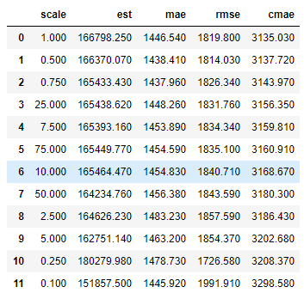
CV example
For holiday scale, the row in blue is the default
There are six values with better cumulative MAE scores.
We could consider taking taking the lowest cumulative mae, mae, or rmse.
Cross Validation

Slide 28
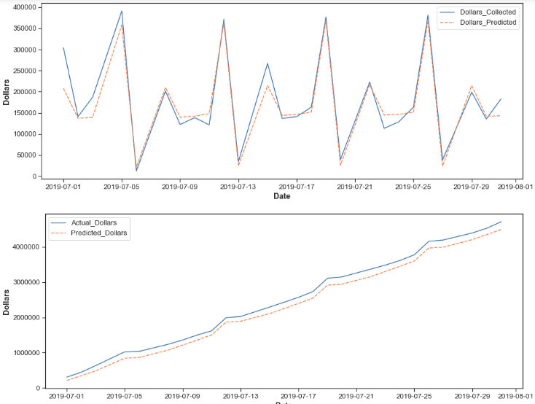
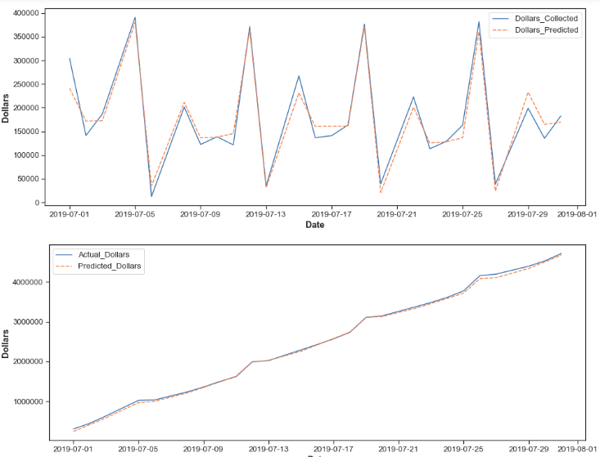
July (test) | Not Tuned | Tuned
MAE | 19,909 | 18,432
CUM MAE | 167,938 | 31,438
RTO-Total Comparison
Not Tuned
Tuned
Cross Validation

Slide 29

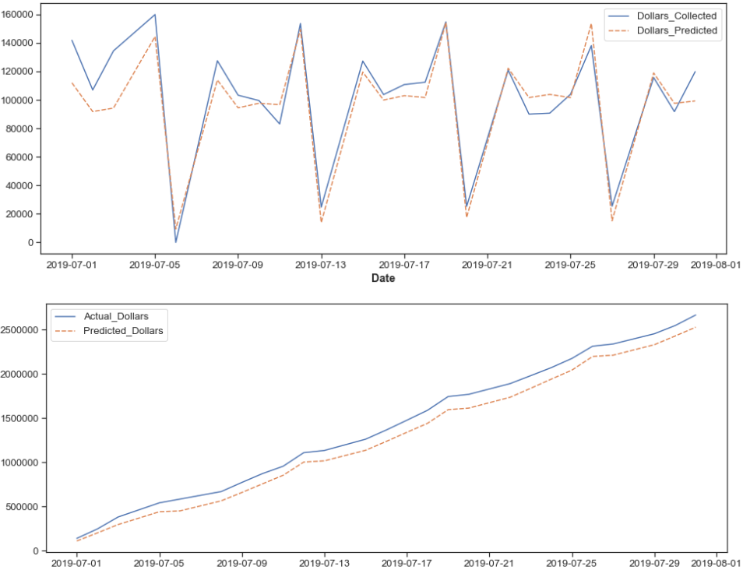
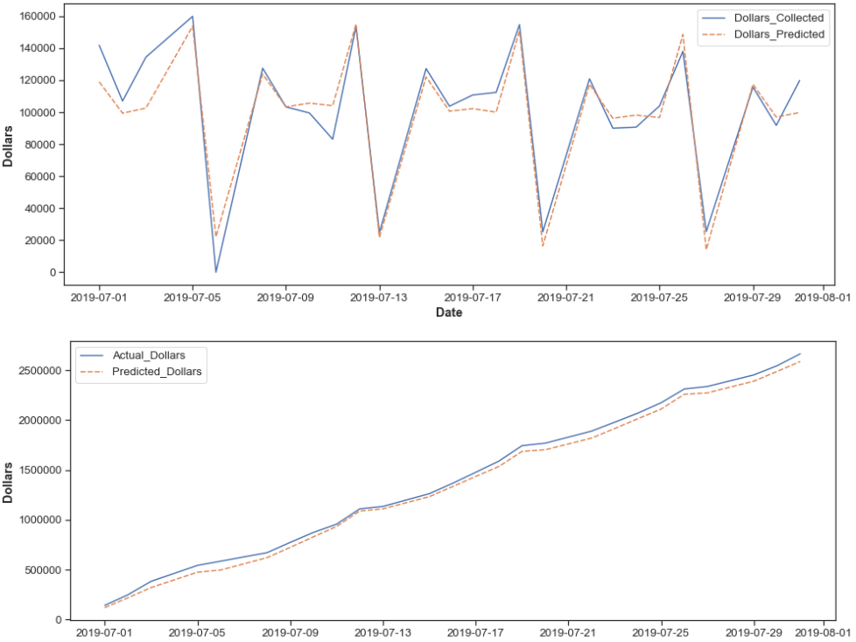
July (test) | Not Tuned | Tuned
MAE | 10,972 | 9,270
CUM MAE | 117,661 | 49,817
RTO-Same Day
Tuned
Cross Validation

Slide 30
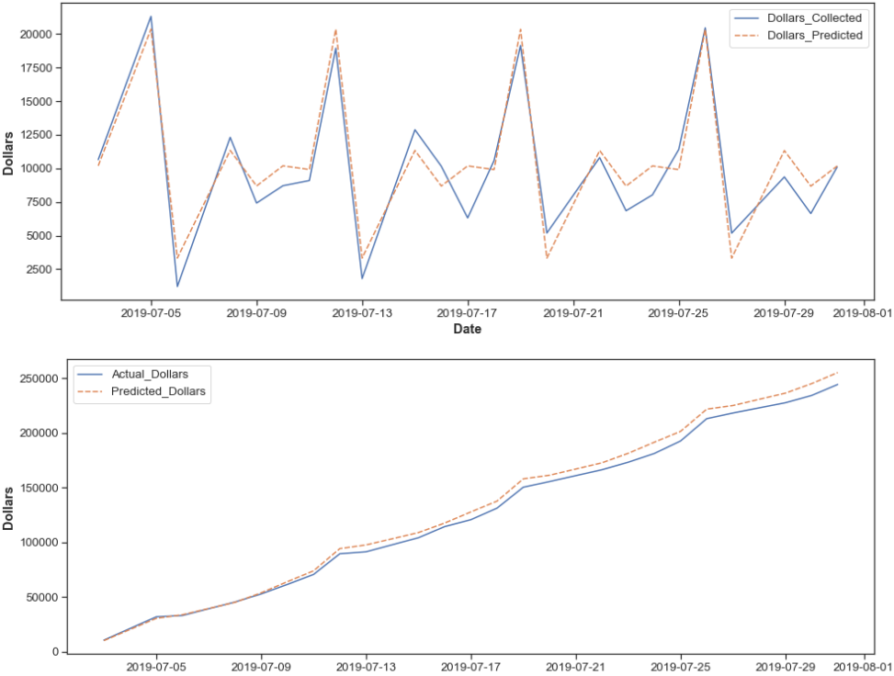
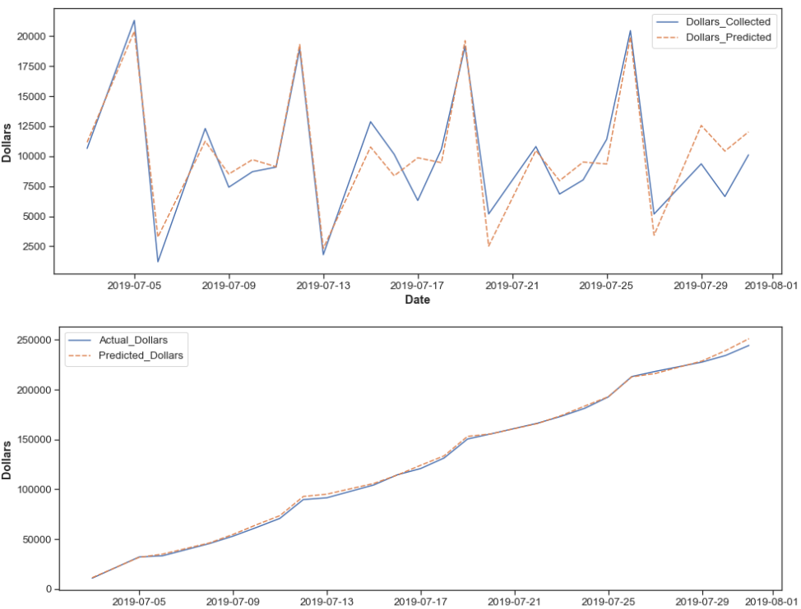
July (test) | Not Tuned | Tuned
MAE | 1,404 | 1,477
CUM MAE | 5,635 | 1,907
Snap Loan – Total
Tuned
Cross Validation

Slide 31
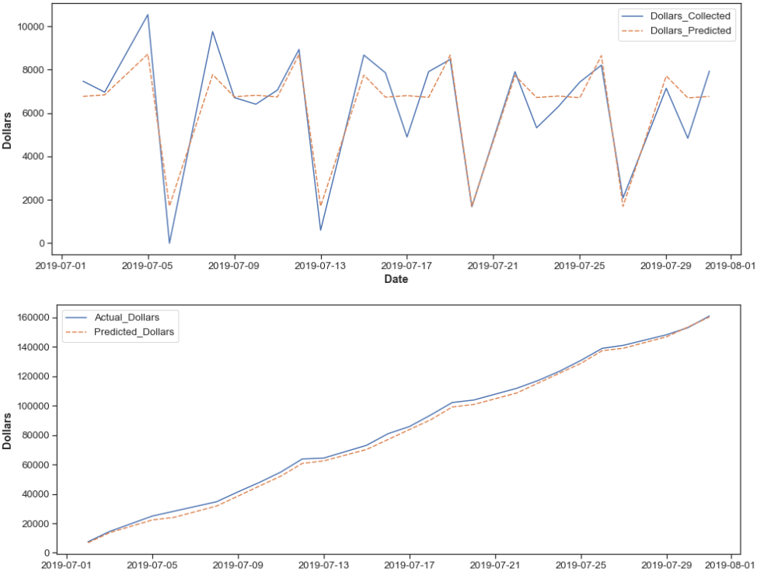
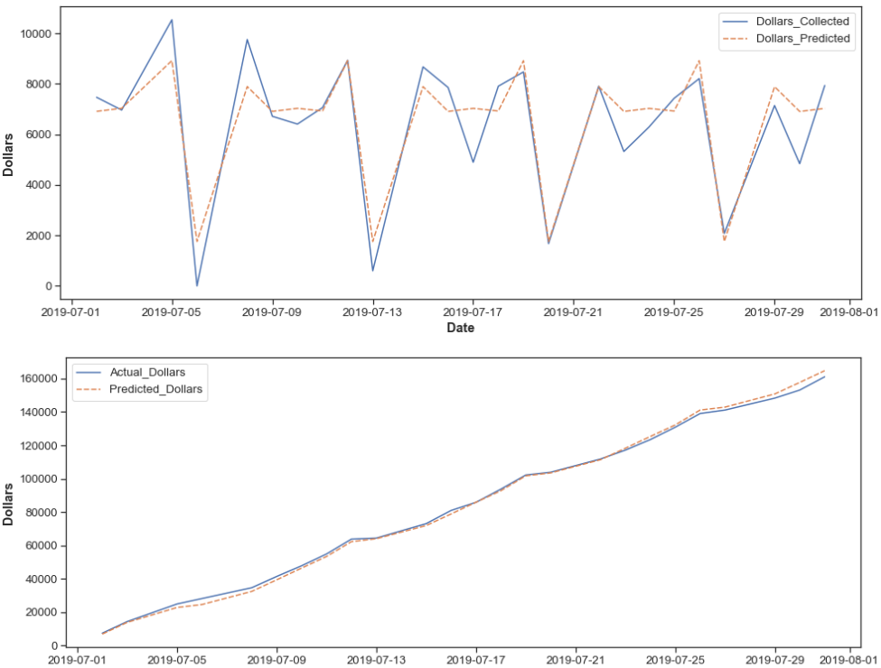
Test (July) | Not Tuned | Tuned
MAE | 840 | 838
CUM MAE | 2,195 | 1,533
Snap Loan – Same Day
Tuned
Cross Validation

Slide 32
Section IV
Model Results

Slide 33
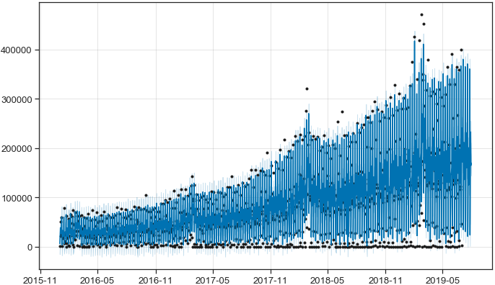
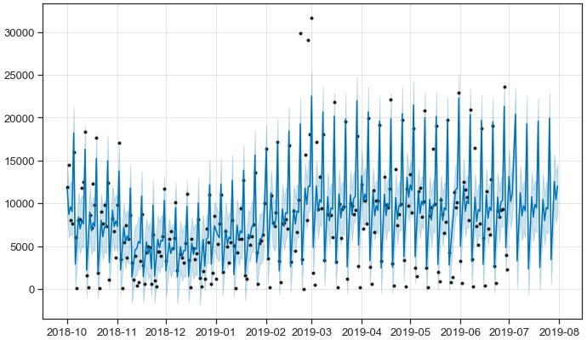
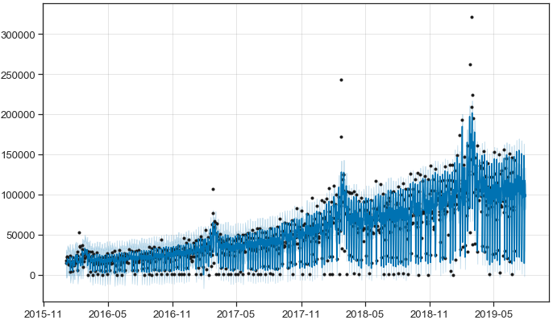
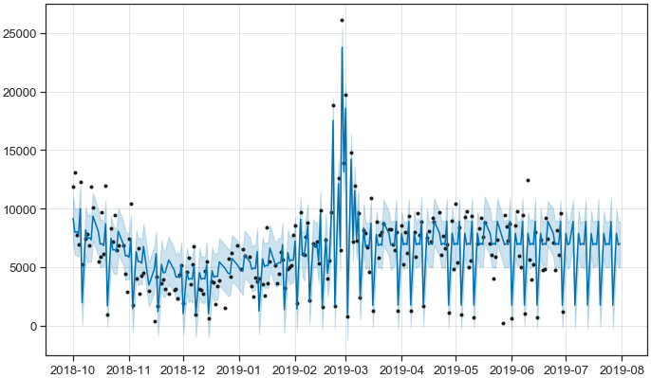
Big Picture Fit
RTO
Snap Loan
Total
Same Day
Results

Slide 34
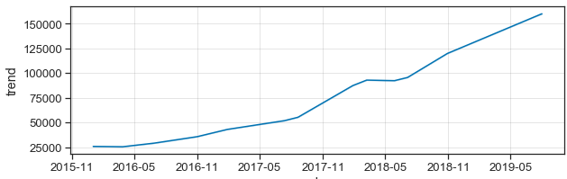
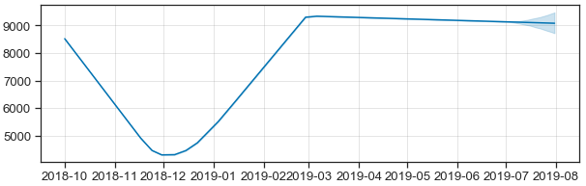
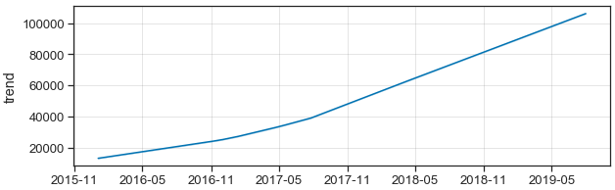
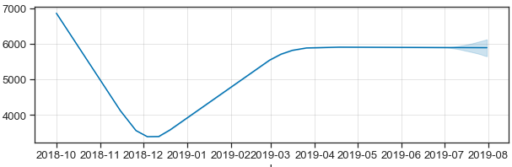
Trend Components
RTO
Snap Loan
Total
Same Day
Results

Slide 35
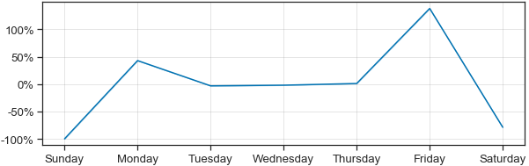
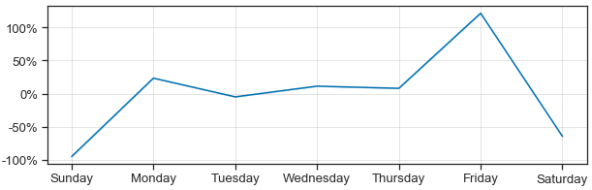
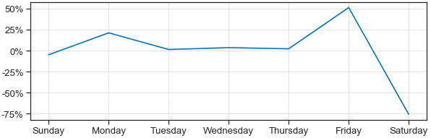
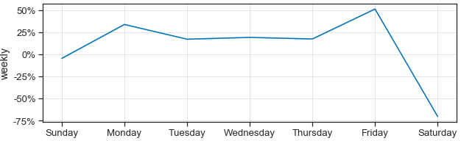
Weekly Seasonality
RTO
Snap Loan
Total
Same Day
Results

Slide 36
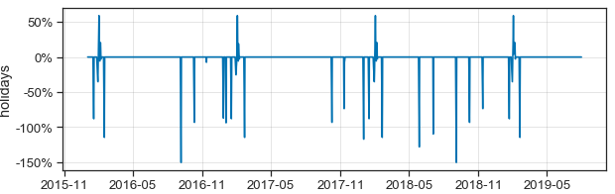
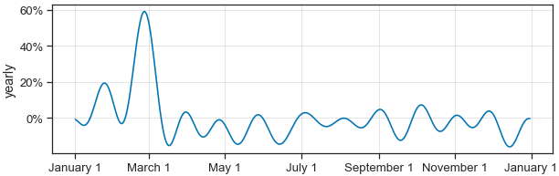
Other Effects (RTO)
Holiday
Yearly Seasonality
Results

Slide 37
Section V
Conclusions / SHiny

Slide 38
Summary
SnapLoan products only had 10 months of data
No yearly seasonality
Tuning/CV should be updated soon
RTO timeseries were relatively stable
Models will likely need to be tuned again
No automated CV algorithm (yet)
CV takes a lot of time (3 hrs)
Retune every 6 months?
Conclusions

Slide 39
Final Product
Collections ShinyDashboard
Improvements for targeted dollar predictions
Separated targets for total and same day dollars
Separated targets for RTO and Snap Loan
A way to view a combined goal for both product types
A cumulative view to check monthly progress
At beginning of a new month, automatically generate new predictions
https://shiny.snapfinance.com/app/CollectionsDashboard
Conclusion

Slide 40
Section VI
Other Projects

Slide 41
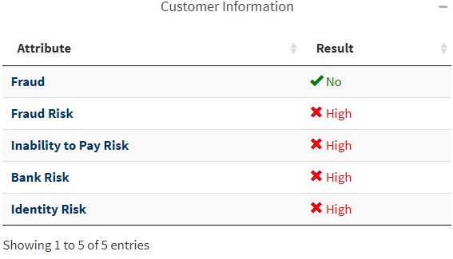
Merchant Verification Code
Background
Merchant support has access to application insights (MSR dashboard)
Sometimes sales reps call merchant support
Problem: No built-in authentication process
Other Projects

Slide 42
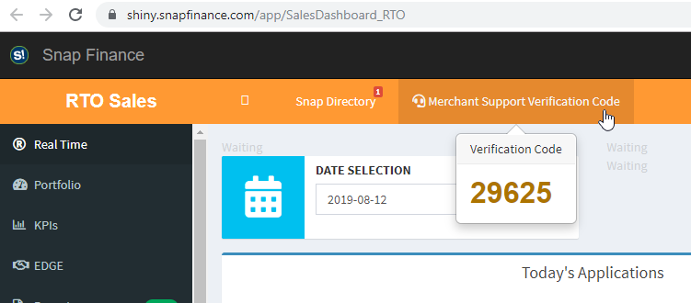
Merchant Verification Code
The plan
Create a PIN identification number at the top of the Sales / MSR dashboard.
Store PIN number in separate database so it’s access across all 5 dashboards.
Have it reset daily via airflow.
“Random” - At least 3 distinct digits
Link
Other Projects

Slide 43
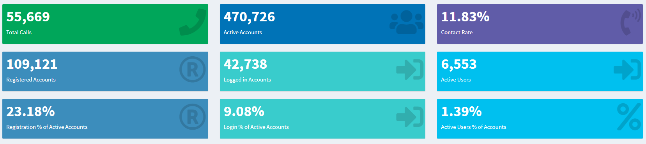
Visualizing an Active Accounts Funnel
Background
The Contact Rate dashboard monitors calls and 4 types of accounts
Active accounts ← Registered Accounts ← Logged-in Accounts ← Active Users
These are nested. How can we visualize this?
https://shiny.snapfinance.com/app/ContactRateDashboard
Other Projects

